Slide 1
Going to School in Taiwan
Chuing Prudence Chou (周祝瑛)
Professor, Cheng-chi University, Taiwan
Email: iaezcpc@nccu.edu.tw
March 30 , 2009

Slide 2
You are going to share with me about Taiwan…
Why you need to know about Taiwan’s education?
What are the major features in Taiwan’s schools?

Slide 3
GNP per capita | 2007 (US$)
Taiwan | 17,252
America | 46,029
Japan | 35,424
Korea | 20,045
Singapore | 33,919
Source: Accounting and Statistics, Executive Yuan, Taiwan.

Slide 4
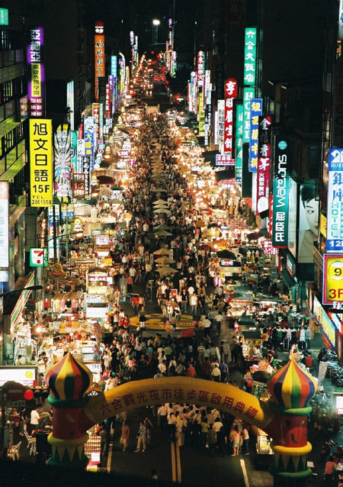
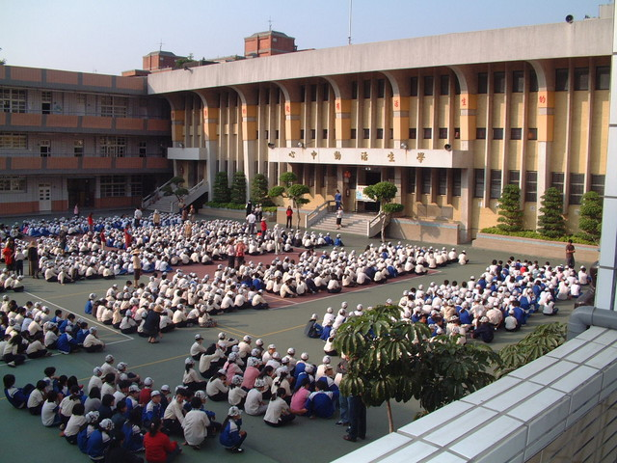
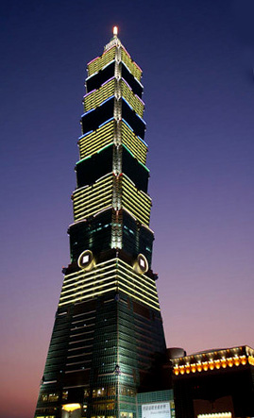
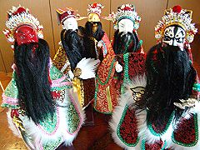
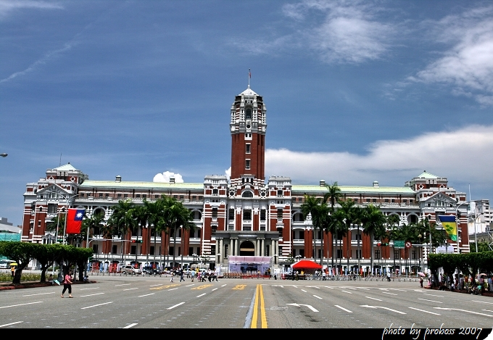

Slide 5
Population (2008 estimate)
305,556,000 (3rd)
Density31/km² (180th)
80/sq mi
Per capita$47,025 (6th)

Slide 6
China vs. Taiwan
Cross-Strait Warming
Taipei - Taiwan and China are to hold a second round of ... thank his Taiwanese hosts. Chen, highest- ranking Chinese official to visit Taiwan since 1949, ...
Senior officials from Taiwan and China are scheduled to hold high-level talks this week ... of warming ties between the traditional rivals. Beijing's top negotiator Chen Yunlin is set to ... agenda are food safety issues after tainted Chinese milk products sickened at least three Taiwanese

Slide 7
Diversity, Efficiency, and Equity

Slide 8
Debates
Centralized and standardized test
Accountability
Equity

Slide 9
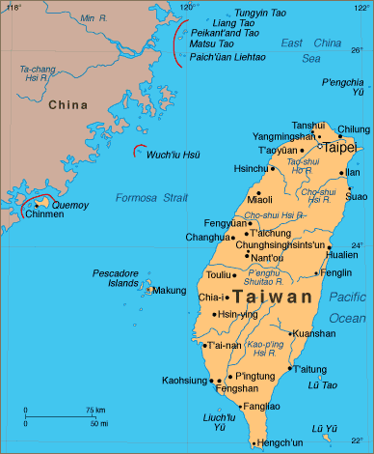

Slide 10
Spot Light : Taiwan
Area :36,000 square kilometers
Population: 23 million
Capital : Taipei City
Language : Mandarin/Taiwanese/Hakka/Indigenous Languages
Religion : Buddhism/Taoism/Christianity/Islam

Slide 11
Demographics
Population : 22.9 million (2005)
About 98% of the population is of Han Chinese ethnicity.
86% are descendants of early Han immigrants known as "native Taiwanese"
The most recent immigrants from mainland China after 1949.
Recent foreign spouses from Vietnam, Indonesia, Thailand and the Philippines

Slide 12
Transnational marriages now account for one out of six births.
The other 2% of Taiwan's population, numbering about 458,000, are listed as the Taiwanese aborigines

Slide 13
Literacy rate: 96.1%
• Men 97% • Women 95%
Enrollment 5,384,926
• Primary 2,153,717
• Secondary 1,676,970
• Post-secondary 1,270,194
Major problem: a drastic declining birth rate since late-1990s

Slide 14
Educational Implication
The New Generation/Sons of Taiwan with foreign mothers
Disadvantaged SES Background
Learning disadvantages

Slide 15
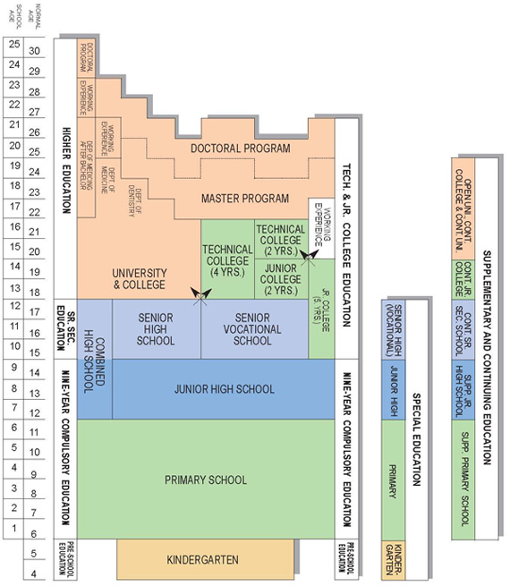

Slide 16
Preschool Education
Nine-Year Compulsory Education
Senior High and Vocational Schools
Special Education
Higher Education
Teacher Education
Supplementary and Continuing Education

Slide 17
A SCHOOL DAY(10th Grade)
Class period | Mon | Tue | Wed | Thu | Fri
7:10–7:20 | Clean campus
7:20–7:50 | Morning homeroom
7:50∼8:10 | Morning meeting
8:10–8:55 | Chinese | Science | English | Geo. | Chinese
9:10–9:55 | Chinese | Chinese | Science | Chinese | Art Performance
10:10–10:55 | Science | English | Math | English | Math
11:05–11:50 | Math | Health & P.E. | Integrated & Activities | Math | Art
11:50–12:30 | Lunch break

Slide 18
12:30∼13:10 | Nap time
13:20–14:05 | School meeting | Civics | Chinese reading | History | English conversation
14:15–15:00 | Class meeting | I & A | Music | English composi-tion | Science
15:00–15:25 | Clean campus
15:25–16:10 | Clubs | I & A | Health and P.E. | English composi-tion | Health & P.E.
16:20–17:05 | English | Math | Chinese | Science | English reading

Slide 19
Educational Reform in Taiwan
1987-88 : the external and internal environmental factors resulting in a series of nation-wide education changes
1989-93 : when the legislators passed many education bills and acts to ensure the reform policies to be based on throughout the country

Slide 20
1994-98 : the Committee of Education Reform under the Executive Yuan drew many representatives from all walks of life to design the theme, framework and progress of the reform, etc.
1999 to date : the numerous negative public opinions against the educational reform programs. The increasing gaps between the urban VS. rural and the rich vs. the poor.

Slide 21
4 Major Educational Issues
Globalization VS. Localization
Gender Stereotyping
Equity of Educational Opportunity
Family Educational expenditure on Cram Schools:
NT$2,640 (US$80) per subject / month

Slide 22
Cram schools
With the intense pressure placed on students to achieve, many students enroll in private after-school classes intended to supplement their regular education.
Popular subjects in cram schools include English, mathematics, and the natural sciences.
Classes are generally very orderly and controlled, with class sizes as high as 200 or so students.

Slide 23
Education Features
PISA 2006 Ranking | Math | Science | Reading Literacy
Taiwan | 1 | 4 | 16
Hong Kong | 3 | 2 | 3
Japan | 10 | 5 | 15
South Korea | 4 | 10 | 1
US | 24 | 20

Slide 24
TIMSS (2003) (13-year-old's average score, International Math and Science Study)
Countries: (sample) | Global rank | Math |  | Science
 |  | Score | Rank | Score | Rank
Singapore | 1 | 605 | 1 | 578 | 1
Taiwan | 2 | 585 | 4 | 571 | 2
South Korea | 3 | 589 | 2 | 558 | 3
Hong Kong | 4 | 586 | 3 | 556 | 4
Japan | 5 | 570 | 5 | 552 | 5
England | 10 | 498 | 18 | 544 | 7
United States | 12 | 504 | 15 | 527 | 11
Sources:TIMSS Math 2003 and TIMSS Science 2003

Slide 25
World-class University Rankings
As the provision of higher educational
opportunities becomes increasingly international,
institutional comparison becomes more in
demand.
The two most frequently cited rankings：
Shanghai Jiaotong University
Times Higher Education Supplement, London

Slide 26
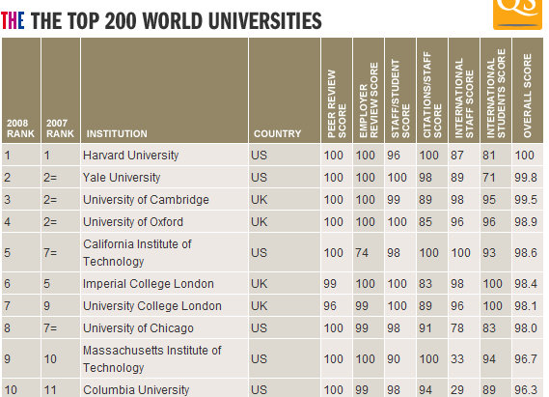
Times

Slide 27
WHAT CAUSES THE GLOBAL RANKINGS AND WHAT THE IMPLICATION TO EDUCATIONAL PRACTICES?
The "Impact of Globalization "
Borrowing and lending reform strategies
In comparative education, there is a great need to examine how local reactions are to these external global forces .
In policy studies, a new paradigm for educational policy-making and school reform is expected to be under way.

Slide 28
What can be learned and imported from elsewhere? (borrowing)
What can be taught and exported elsewhere? (lending),
The phenomena of cross-national policy attraction and educational borrowing
Global and international convergence in education at the expense local needs and cultural diversity

Slide 29
The two sides of the Taiwan Strait have since been governed as separate territories and developed separate identities.
In the realm of political development, Taiwan has grown into a free and vibrant democracy. The government lifted martial law in 1987 and launched a series of political reforms to expand the democratic process. In 1996, the people of Taiwan completed their first direct presidential election. The presidential election of 2000 and 2008 were peacefully transferred power between Democratic Progressive Party (DPP) and KMT.

Slide 30
Education in 2020
What will happen to the next generations of China and Taiwan after a series of nation-wide educational reforms?
What are the follow-ups and outcomes?
Who benefit and who suffer as a result of these reform programs ?
What do learn from each other?

Slide 31
Thank you for your attention.
God Bless!
Chuing Prudence Chou (周祝瑛)
Professor, Cheng-chi University, Taiwan
Email: iaezcpc@nccu.edu.tw
March 31 , 2009

